Slide 1
Software Architecture and Design Patterns
- By Pratik Pol

Slide 2
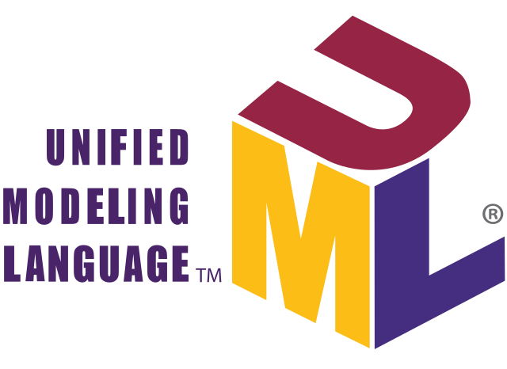
#UML – The Notation
INDRODUCTION
UML (Unified Modeling Language) is a standard visual modeling language for software system design.
Used to represent the structure, behavior, and interactions of a system.
Created to provide a common language for developers, analysts, and designers.

Slide 3
UML is visual, not a coding language.
It helps plan, communicate, and document the system.
Supports object-oriented concepts like classes, inheritance, and polymorphism.
Used in analysis, design, and implementation phases of SDLC.
Ex:- If you’re building a house, you first create a plan with rooms, doors, and layout. UML does the same for software.
Why UML is Important
Brings clarity between client and developer.
Reduces misunderstanding in teams.
Helps reuse designs for future projects.
Provides documentation for maintenance.
Ex:- Imagine a banking project. Without UML, the team may confuse account transfer process with withdrawal process. UML diagrams remove such confusion

Slide 4
ARROW TYPES
Arrow Type | Symbol | Meaning / When to Use
Association | ― (Solid line) | Permanent relationship between two classes/objects. (e.g., Order and Customer)
Directed Association | ―▶ (Solid line with arrow) | Shows the direction of the relationship.
Aggregation | ◇― (Hollow diamond) | "Has-a" relationship but weak. (Library has Books)
Composition | ◆― (Filled diamond) | Strong "Has-a" relationship. Child cannot exist without parent. (House has Rooms)
Inheritance / Generalization | ―▷ (Solid line with hollow arrow) | Child class inherits from a parent class.
Realization | - -▷ (Dashed line with hollow arrow) | Class implements an interface.
Dependency | - -▶ (Dashed line with arrow) | One class temporarily depends on another.
Message Call (Sequence Diagram) | → (Solid arrow) | One object sends a message to another.
Return Message | ← (Dashed arrow) | Response sent back to the caller.
State Transition | → (Solid arrow) | Move from one state to another.
Control Flow (Activity Diagram) | → (Solid arrow) | Flow of steps in a process.

Slide 5
# Main Categories of UML Notations
UML notations are divided into Structural and Behavioral diagrams.
Structural (Represent the static aspects of a system) | Behavioral (Represent the dynamic aspects of a system)
Class Diagram – Shows classes, attributes, methods, and relationships. | Use Case Diagram – Actors and their interactions with the system.
Object Diagram – Snapshot of system objects at a particular moment. | Sequence Diagram – Time-ordered flow of messages between objects.
Component Diagram – Describes software components and dependencies. | Activity Diagram – Flow of control or data within a process.
Deployment Diagram – Shows hardware nodes and software deployment. | State Machine Diagram – States of an object and transitions.
Package Diagram – Groups related classes/components.

Slide 6
Structural Diagram :-
Diagram | Symbol | When to Use
Class Diagram | Rectangle (3 parts: Name, Attributes, Methods) + arrows | Show classes, properties, methods, and relationships.
Object Diagram | Underlined object name in rectangle | Show a snapshot of object instances.
Component Diagram | Rectangle with 2 small tabs (component icon) | Show software modules/components.
Deployment Diagram | 3D Box (Node) + connection lines | Show hardware nodes & where software is deployed.
Package Diagram | Folder icon | Group related classes into packages.

Slide 7
Behavioral Diagrams-
Diagram | Symbol | When to Use
Use Case Diagram | Actor (stick figure), Use Case (oval), association line | Show how users interact with the system.
Sequence Diagram | Lifeline (vertical dashed line), Message arrows →, Return arrows ← | Show object communication over time.
Activity Diagram | Rounded rectangle (action), Diamond (decision), arrows (flow) | Show process flow or algorithms.
State Machine Diagram | Rounded rectangle (state), arrow (transition) | Show different states of an object.
Communication Diagram | Objects with numbered arrows | Show interactions between objects.

Slide 8
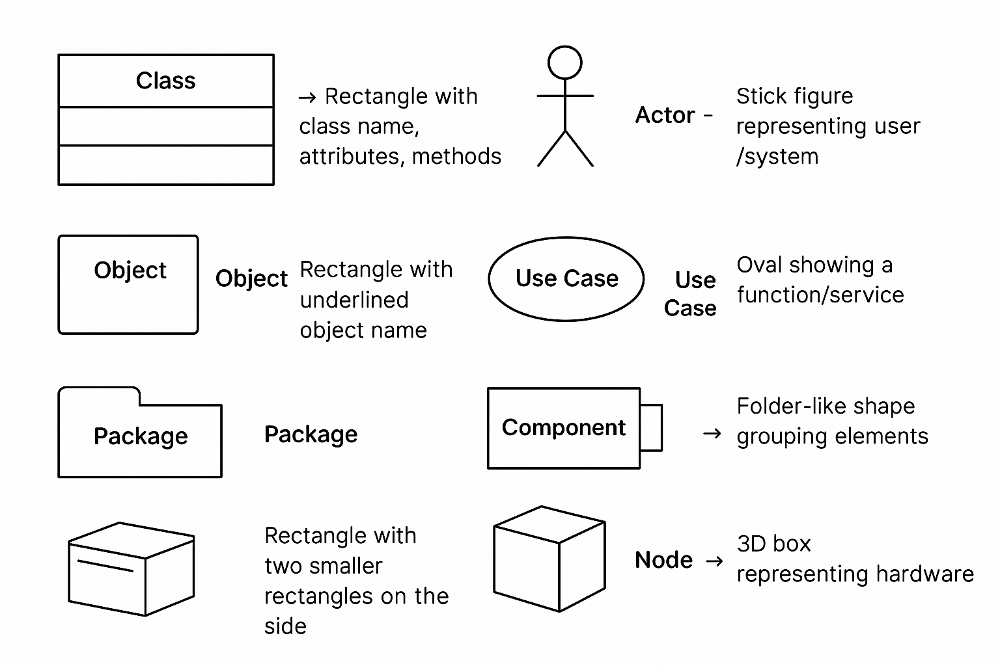
Basic UML Notation Elements
Class → Rectangle with class name, attributes, methods.
Object → Rectangle with underlined object name.
Actor → Stick figure representing user/system.
Use Case → Oval showing a function/service. Package → Folder-like shape grouping elements.
Component → Rectangle with two smaller rectangles on the side.
Node → 3D box representing hardware. slides

Slide 9
Structural -1) Class Diagram
* What is a Class?
A blueprint for creating objects in Object-Oriented Programming (OOP).
Defines attributes (data) and methods (functions) that the objects will have.
In UML, a class is shown as a rectangle with three parts – Name, Attributes, Methods.
EX:-A car class can have attributes like color, model and methods like start(), stop().
UML Notation-
Top section → Class name (first letter capital, bold or centered).
Middle section → Attributes (variables, with visibility symbols ‘+’ Public , ‘-’ Private , ‘#’ Protected )
Bottom section → Methods/Operations (functions with parameters).
Car
-color: String -model: String
+start(): void +stop(): void
‘+’ Public | visible to all classes
‘-’ Private | visible only within the class
‘#’ Protected | visible to subclasses

Slide 10
Relationship Between Classes
Purpose of Class Diagram
Association – General connection between two classes (e.g., Teacher — teaches — Student).
Inheritance (Generalization) – One class inherits attributes/methods of another (is-a relationship).
Aggregation – Whole–part relationship (weak link; parts can exist independently).
Composition – Strong whole–part relationship (parts cannot exist without the whole).
Shows static structure of a system.
Helps visualize classes and their relationships before coding.
Acts as a blueprint for developers.
Useful in both analysis (understanding requirements) and design stages.
Benefits of Class Diagram
Improves understanding and communication among team members.
Helps in planning and organizing system structure.
Easy to identify and fix design problems early.
Serves as documentation for future maintenance.

Slide 11
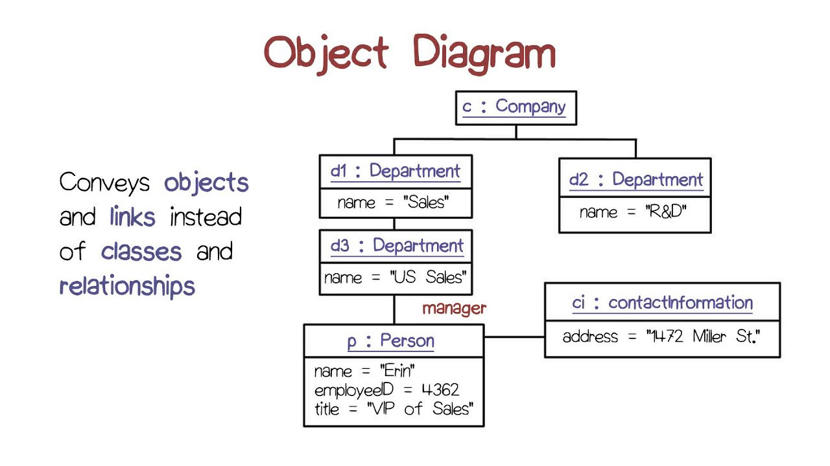
2) Object diagram
*What is an Object Diagram?
A snapshot of the system at a specific point in time.
Shows objects (instances of classes) and their relationships.
Similar to a Class Diagram, but focuses on actual data in objects.
Often used to illustrate examples of real objects in the system.

Slide 12
Benefits of Object Diagram
Gives a clear picture of how objects interact in reality.
Helps detect unnecessary relationships or unused objects.
Bridges the gap between theoretical design and real system.
Supports better communication between designers and testers.
*UML Object Diagram Notation
Object name is underlined (e.g., car1 : Car).
Attributes are shown with current values (e.g., color = "Red").
Links between objects show their relationship at runtime.
Objects are represented as rectangles with name and values.

Slide 13
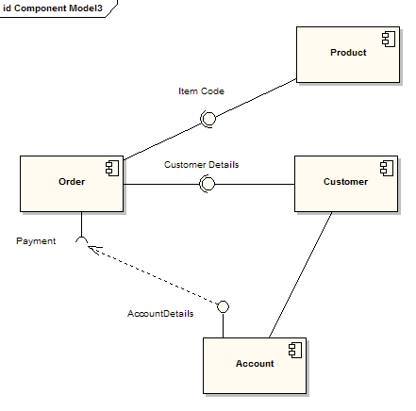
3)Component Diagram
What is a Component Diagram?
A structural diagram in UML that shows how software components are connected.
Represents high-level parts of the system like modules, executables, libraries.
Focuses on the physical structure rather than the logic.
Useful for visualizing system implementation.

Slide 14
Purpose of Component Diagram
To show organization and relationships between components.
Helps understand how the system is built in physical form.
Shows interfaces that components use to interact.
Aids in deployment planning.
Benefits of Component Diagram
Improves system architecture understanding.
Helps in planning module reuse.
Clarifies dependencies between parts.
Assists in maintenance and upgrades.
UML Component Diagram Notation
Component → Rectangle with two small rectangles (tabs) on the left side.
Interface → Small circle (lollipop) or half-circle (socket).
Dependency → Dotted arrow from dependent to the provider.
Packages can group related components.

Slide 15
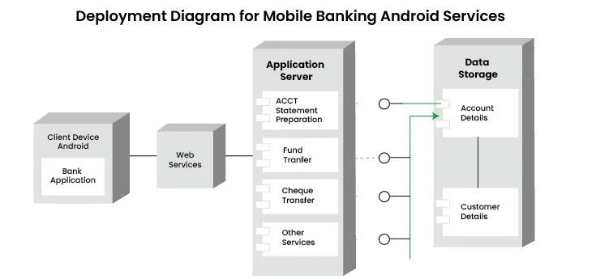
4) Deployment Diagram
What is a Deployment Diagram?
A structural UML diagram that shows the physical arrangement of hardware (nodes) and software (artifacts).
Describes where and how the system’s components are deployed.
Useful for modeling the runtime environment of a system.
Focuses on infrastructure, not just software logic.

Slide 16
UML Deployment Diagram Notation
Node → 3D box representing hardware or device.
Artifact → Rectangle representing a deployed software file or module.
Communication Path → Line showing a connection between nodes.
Stereotypes → (<<device>> <<execution environment>> ) ) to clarify node types.
Purpose of Deployment Diagram
To show the hardware setup for a system.
To illustrate how software is deployed on that hardware.
To understand network connections between devices.
To help in capacity planning and performance analysis.
Benefits of Deployment Diagram
Provides a clear picture of system deployment.
Helps in planning physical system setup.
Ensures correct software-to-hardware mapping.
Improves communication between developers and IT team.

Slide 17
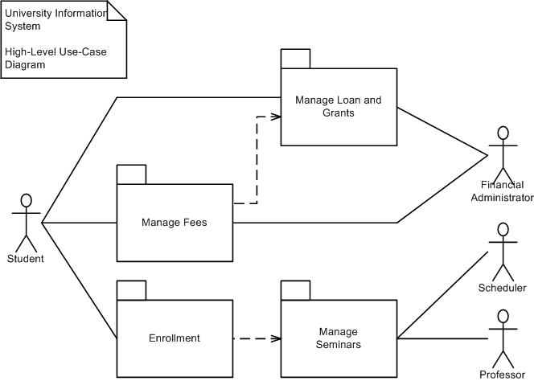
5) Package Diagram
What is a Package Diagram?
A structural UML diagram that shows how classes or components are grouped into packages.
Helps organize large systems into smaller, manageable units.
Each package can contain classes, components, or other packages.
Used mainly in high-level system design.

Slide 18
UML Package Diagram Notation
Package → Folder-shaped symbol with the package name at the top tab.
Contained Elements → Inside the package (classes, interfaces, etc.).
Dependency → Dotted arrow from one package to another.
Import/Merge relationships to indicate how packages interact.
Benefits of Package Diagram
Provides clear modular structure for large projects.
Improves code reusability by grouping related elements.
Makes navigation in complex systems easier.
Supports parallel development by dividing work into packages.
Purpose of Package Diagram
To organize and group related elements in a system.
To reduce complexity in large designs.
To visualize dependencies between different parts of the system.
To make the system easier to understand and maintain

Slide 19
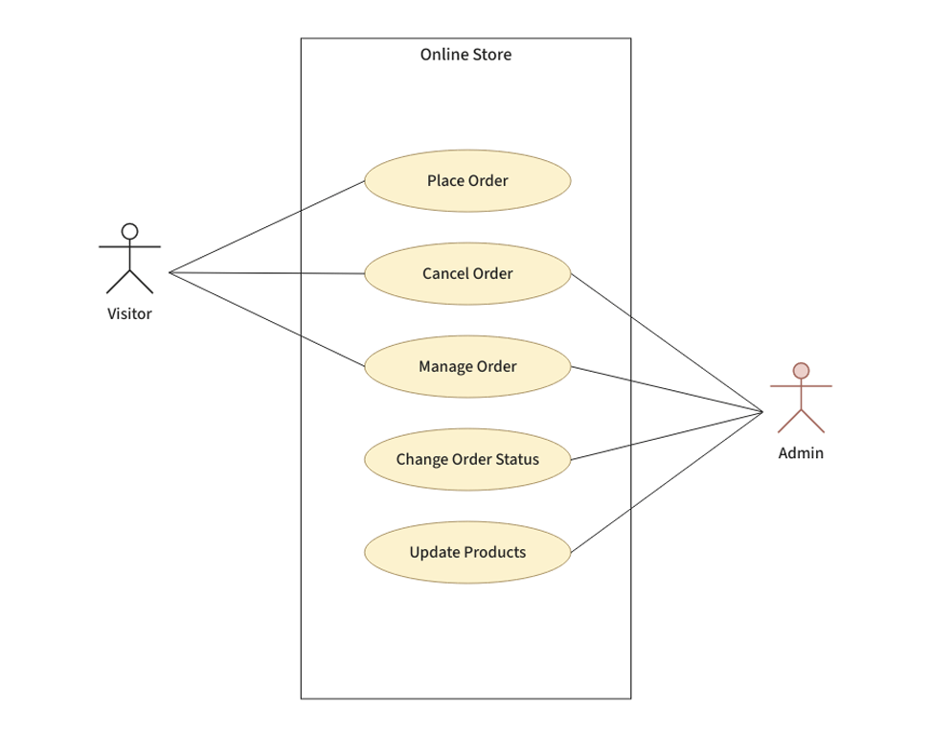
2) Behavioral
1) Use Case Diagram
A behavioral UML diagram that shows the interaction between users (actors) and the system.
Focuses on what the system does (functional requirements), not how it works.
Represents system functionality as use cases (ovals).
Useful in requirement gathering and communicating with non-technical stakeholders.

Slide 20
Purpose of Use Case Diagram
To identify system functionalities from a user’s perspective.
To capture requirements clearly during early development.
To communicate between clients, developers, and testers.
To define scope of the system.
Benefits of Use Case Diagram
Simple to understand for both technical and non-technical people.
Helps in requirement validation before development.
Ensures all user interactions are considered.
Serves as a basis for test case creation.
UML Use Case Diagram Notation
Actor → Stick figure representing a user or another system.
Use Case → Oval showing a system function/service.
System Boundary → Rectangle enclosing all use cases.
Relationships:
Association (line between actor and use case)
Include (dashed arrow with<<include>> )
Extend (dashed arrow with <<extend>> )

Slide 21
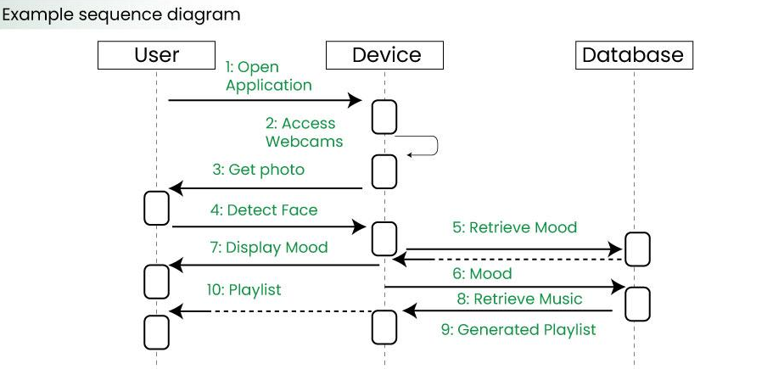
2) Sequence Diagram
What is a Sequence Diagram?
A behavioral UML diagram that shows the order of interactions between objects over time.
Focuses on how and in what sequence messages are passed.
Represents objects as lifelines and their communication as messages.
Useful for understanding logic flow in a process.

Slide 22
UML Sequence Diagram Notation
Object/Lifeline → Rectangle with object name at the top, dashed vertical line downwards.
Activation Bar → Narrow vertical rectangle showing when an object is active.
Message → Arrow from sender to receiver (solid for synchronous, dashed for return).
Time Flow → Always goes from top to bottom.
Purpose of Sequence Diagram
To show the detailed flow of control between objects.
To visualize communication in a particular scenario.
To identify order of operations for implementation.
To validate design before coding.
Benefits of Sequence Diagram
Makes process flow clear for developers and testers.
Helps in debugging by tracing message flow.
Supports documentation of system behavior.
Bridges the gap between requirements and code.

Slide 23
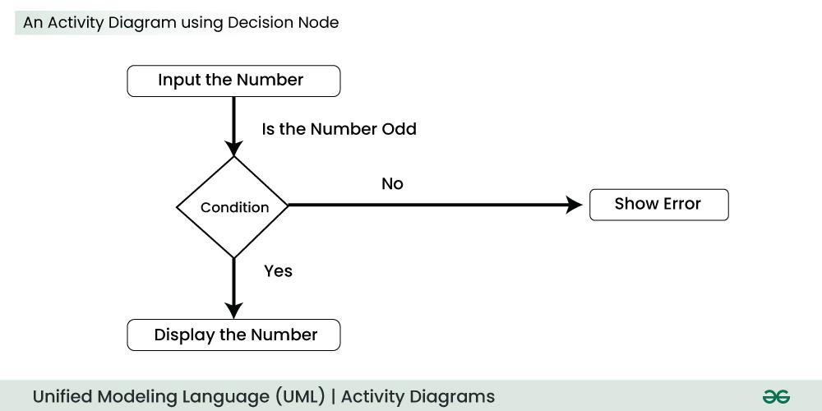
3) Activity Diagram
A behavioral UML diagram that shows the workflow or activities of a process.
Focuses on step-by-step actions and decision points.
Similar to a flowchart but follows UML standards.
Used to model business processes and system workflows.

Slide 24
UML Activity Diagram Notation
Initial Node → Filled black circle (start point).
Activity/Action → Rounded rectangle for each step.
Decision/Merge Node → Diamond shape for branching.
Final Node → Black circle with an outer ring (end point).
Purpose of Activity Diagram
To represent how work flows through a system or process.
To identify decision points and alternate paths.
To visualize parallel processes using forks and joins.
To help in business process analysis.
Benefits of Activity Diagram
Easy to understand for all stakeholders.
Helps in requirement clarification.
Highlights bottlenecks in processes.
Serves as a blueprint for workflow implementation.

Slide 25
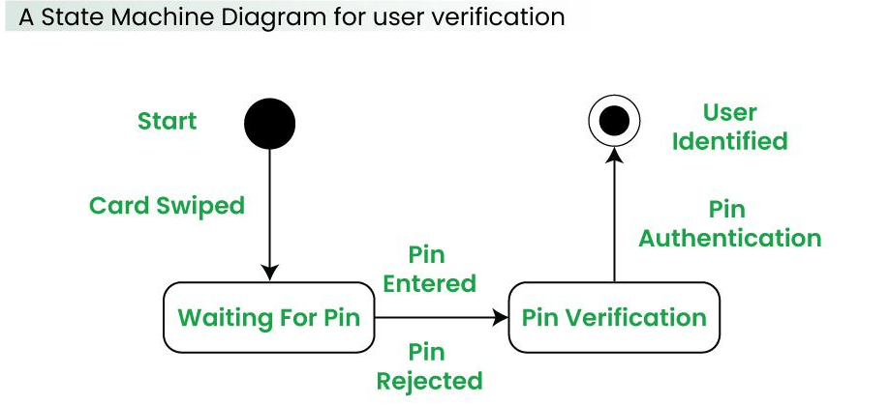
4) State Machine Diagram
A behavioral UML diagram that shows the states an object goes through during its lifetime.
Focuses on transitions triggered by events.
Used to model reactive systems that respond to inputs/events.
Shows how an object changes its behavior over time.

Slide 26
ML State Machine Diagram Notation
State → Rounded rectangle with the state name inside.
Initial State → Filled black circle (start).
Final State → Black circle with an outer ring (end).
Transition → Arrow showing movement from one state to another, labeled with the triggering event
Purpose of State Machine Diagram
To visualize the lifecycle of an object.
To model event-driven behavior.
To help developers implement correct state handling.
To ensure no missing transitions in the design.
Benefits of State Machine Diagram
Makes system behavior clear for complex, event-based systems.
Reduces errors in state handling.
Supports testing by identifying all possible states and transitions.
Improves communication between analysts, designers, and developers.

Slide 27
Unified Process
Definition – UP is a software development methodology used in Object-Oriented Analysis and Design (OOAD).
Iterative Development – Development is carried out in small iterations, allowing regular feedback and continuous improvement.
Collaboration – Encourages strong collaboration between developers, stakeholders, and customers.
Flexibility – Adaptable to different project needs and team structures.
Based on UML – Uses Unified Modeling Language (UML) for modeling and documentation.
Use Case Driven – Uses use cases to define system functionality and guide development activities.
Architecture-Centric – Focuses on designing a strong and scalable architecture early in the process.
Risk Management – Identifies and addresses high-risk areas early in development.
Incremental Delivery – Delivers the product in small, functional increments to ensure continuous value delivery.
Tailorable Process – Can be customized to fit the specific requirements of a project or organization.
Popularity – Widely used by software teams due to its balance of structure and flexibility.

Slide 28
4 Phases :-
1. Inception Phase
Goal: Understand the project scope, feasibility, and basic requirements.
2 Elaboration Phase
Goal: Establish a solid architecture and address major risks.
3 Construction Phase
Goal: Develop and build the complete product incrementally.
4 Transition Phase
Goal: Deploy the system to users and ensure smooth operation.

Slide 29
Example: Developing an Online Shopping Website
1. Inception (Concept and Goals)
The client says: “I want a website where people can buy products online.”
Use Cases are created:
User login
Browsing products
Adding products to the cart
Making payments
Main goals defined: “Easy shopping experience and secure payments.”
2 Elaboration (Architecture and Planning)
The team decides on the website architecture:
How will the login system work?
How to store user and product data in the database?
Risks like “How to keep payments secure?” are addressed first.
UML diagrams are created—like class diagrams, sequence diagrams.

Slide 30
Example: Developing an Online Shopping Website
3.Construction (Building)
Coding begins.
In the first iteration, only login and product browsing features are developed.
This part is delivered to the client and feedback is taken.
In the second iteration, cart and payment features are added.
Testing is done after every iteration.
4.Transition (Deployment)
The full website is completed.
It’s delivered to the client and users are trained.
Bugs found are fixed.
The website goes live and people start using it.

Slide 31
What can we learn from this example?
In UP, software is developed incrementally, not all at once.
Development is driven by use cases and client feedback is regularly gathered.
Risks are handled early (e.g., payment security).
Each phase includes testing and improvements.

Slide 32
2) Elaboration Phase
3) Construction Phase
Goal: Analyze problem domain and create the architectural foundation.
Define detailed requirements using use case models.
Develop baseline architecture.
Resolve high-risk elements.
Prepare iteration plans.
Output → Software Architecture Document (SAD), Detailed Use Cases, Updated Risk List, Prototypes.
Architecture baseline is created.
Risk reduction is the focus.
Detailed requirements defined.
Goal: Build the software product.
Develop and integrate components.
Implement all remaining features.
Perform unit, integration, and system testing.
Prepare for product release.
Output → Software Product, Test Results, User Documentation.
Main coding and development phase.
Testing happens here in parallel.
Iterative builds until ready.

Slide 33
4) Transition Phase
Goal: Deliver the product to users and ensure it works in the real environment.
Beta testing, bug fixing.
User training and support setup.
Deploy product to production environment.
Final adjustments based on feedback.
Output → Final Product Release, Training Material, Support Plan.
User acceptance is key.
Bug fixing before release.
Focus on deployment and support.

Slide 34
Rational Unified Process (RUP)
Definition: RUP is a detailed and refined version of the Unified Process developed by Rational Software (now IBM).
Iterative and Incremental: Like UP, RUP divides development into small iterations with incremental deliveries.
Use-Case Driven: Development is guided by clearly defined use cases describing system behavior.
Architecture-Centric: Focuses on creating a robust architecture early to support future development.
Risk-Focused: Emphasizes identifying and mitigating high risks early in the process.
Disciplines/Workflows: Organized into workflows like Requirements, Analysis & Design, Implementation, Testing, Deployment, and Configuration Management.
Phases: Includes the same four phases as UP — Inception, Elaboration, Construction, and Transition.
Best Practices: Provides detailed guidelines, templates, and tools for software development teams to follow.
Tailorable: Can be customized to suit the needs of different projects and organizations.
Supported by Tools: Often used with IBM Rational tools like Rational Rose, Rational ClearCase, Rational RequisitePro, etc.

Slide 35
Rational Unified Process (RUP) example
1 Inception Phase:
The client wants a secure banking application to manage accounts, transfers, and loans.
Use Cases identified: Account creation, Fund transfer, Loan application, Account statement.
Project scope and initial requirements are defined.
2. Elaboration Phase:
The architecture is designed, including server setup, database schema, and security mechanisms.
High-risk areas like transaction security and data encryption are addressed first.
UML diagrams such as class diagrams and sequence diagrams are prepared.
3. Construction Phase:
Coding begins with core modules like account management and fund transfer.
Development is done in iterations; after each iteration, the client reviews the progress and gives feedback.
Additional features like loan processing and account statements are developed in subsequent iterations.
4. Transition Phase:
The completed application is deployed to the client’s environment.
User training and documentation are provided.
Bugs found during real-world usage are fixed.
The application goes live and starts handling real transactions.

Slide 36
Difference between UP & RUP
Point | Unified Process (UP) | Rational Unified Process (RUP)
1. Definition | General iterative and use-case driven framework. | Detailed, tool-supported implementation of UP by Rational Software.
2. Phases | Four phases: Inception, Elaboration, Construction, Transition. | Same four phases with detailed activities and deliverables.
3. Documentation | Basic guidelines and concepts. | Extensive documentation, templates, and best practices.
4. Tool Support | No mandatory tools specified. | Supported by IBM Rational tools like Rational Rose, ClearCase, RequisitePro.
5. Risk Management | Conceptual emphasis on risk management. | Well-defined, formal risk management process.
6. Tailorability | Highly adaptable to project needs. | Adaptable but with stricter process guidelines for consistency.

Slide 37
How Various Components Fit in the Life Cycle
Overview of Software Development Life Cycle (SDLC): The SDLC is divided into phases or disciplines, each with specific goals and deliverables. Components like requirements, design, implementation, testing, and deployment fit into these phases.
Processes/Disciplines in Iterative Models (like UP/RUP):
Requirements: Understanding and documenting what the system must do.
Analysis and Design: Defining the system architecture, components, and interfaces.
Implementation: Writing the actual code and building the system.
Testing: Verifying the system against requirements and detecting defects.
Deployment: Releasing the system to users and supporting it in production.
Configuration Management: Managing changes, versions, and baselines.
Project Management: Planning, monitoring, and controlling the project.
Environment: Setting up tools and processes to support development.
How Components Fit: Each component or activity contributes to specific disciplines and phases, creating artifacts (documents, models, code) that progressively refine the system.

Slide 38
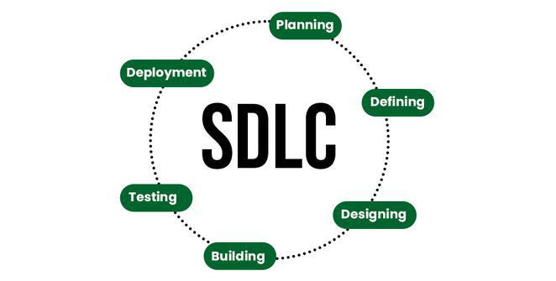

Slide 39
Artifacts Produced at End of Each Process / Discipline
Process / Discipline | Artifacts Produced
Requirements | Requirements Specification Document, Use Case Models
Analysis & Design | Architecture Models, Design Diagrams (Class Diagrams, Sequence Diagrams), Data Models
Implementation | Source Code, Executable Modules, Build Scripts
Testing | Test Plans, Test Cases, Test Reports, Defect Logs
Deployment | Installation Guides, User Manuals, Deployment Plans
Configuration Management | Version Control Records, Change Requests, Baseline Reports
Project Management | Project Plans, Schedules, Risk Management Plans, Status Reports
Environment | Tool Configurations, Development Environment Setup Docs

Slide 40
Refer this website for more info
https://www.geeksforgeeks.org/system-design/unified-process-in-ooad/

